Slide 1
MARE/2020/08 - SI2.839444
Development of the Regional Database for the Mediterranean & Black Seas (Med&BS RDBFIS)
This project has financed under the European Maritime and Fisheries Fund (EMFF)
CINEA/EMFAF/2021/3.1.2/03/SC04/SI2.881222
Specific Contract 2021/3.1.2/03/SC04
Hosting, maintenance and further development of the Regional Database for the Mediterranean and Black Seas
(period: 01/04/2023 – 31/03/2025)

Slide 2
Overview of the RDBFIS web application
RDBFIS web application software architecture
Graphical User Interface Design
Access and Security subsystem
Live demonstration on a high level
Notes:
My presentation consists of 4 parts: First I will present an overview of the RDBFIS web application software architecture, Then I will proceed with the Graphical User Interface Design. I will also give an overview of the Access and Security subsystem. Finally I will perform a live demonstration of the web application on a high level.

Slide 3
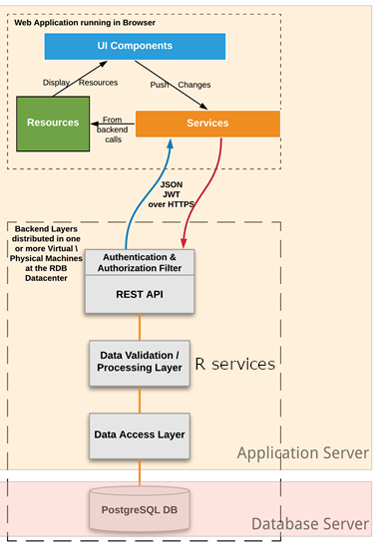
Overview of the RDBFIS web application
RDBFIS software architecture
High level view of the software architecture
Application Server
Angular Web Application components
Springboot REST API / Authentication&Authorization filters
R Data Validation / Processing web services (via Plumber)
Data Access Repositories
Docker images:
Java Application Server
Multiple R server instances served through a HAproxy load balancer behind a highly performing nginx Web Server)
Database Server
Postgres 13 at rdbfis.ath.hcmr.gr

Slide 4
Overview of the RDBFIS web application
Graphical User Interface design
The design of the GUI follows the main guidelines of human-centered user interface design: simplicity, consistency, purposefulness, communication of status information and clarity.
Hierarchical navigation menu in a vertical sidebar (appropriate functionality in one move).
Upper levels: Data Calls, Surveys, Stomach Contents, Eggs & Larvae, Alien/Invasive Species, Recreational Fisheries, Litter, EU Fleet Data, Spatial Analysis, Environmental, Codification System.
Under Data Calls users can navigate to FDI, Med&BS, GFCM/DCRF, RCG, STECF/GFCM , AER Socioeconomic and GFCM Socioeconomic data calls, under Surveys users can navigate to MEDITS and MEDIAS surveys
Tab Panel per component UI View (e.g. Med&BS Data Call includes Tabular Visualization, Graphs, Import and Processing tabs). Easy incorporation of additional tabs and functionalities.

Slide 5
Overview of the RDBFIS web application
Access and Security System
The Security System of the platform enforces Role-based Access Control on the Med&BS RDBFIS data.
4 roles / access levels to the system:
Administrator role which may access all functionalities and data;
Guest role (open access level) which may access only publicly available EU Fleet data as well as the entries of the Med&BS RDBFIS Codification System
Member State level having access solely to own data;
The Member State level is further subdivided into sub-levels: a user may have only read access to Member State data or both read/write access. Furthermore, a user may only have read or read/write access on a specific Geographical Subarea.
Special Purpose User level (e.g. STECF to access only Med&BS data).
All data exchanges are encrypted using the TLS cryptographic protocol. The passwords of the users are stored in an encrypted form in the database (BCrypt algorithm) and the access to the Web Service API is restricted by using Spring Security with JSON Web Tokens.

Slide 6
Live Demonstration https://medbs-rdbfis.hcmr.gr
Overview of the RDBFIS web application

